Slide 1






Product Requirement Document (PRD) - Edusakha Events Feature
An Interface for conducting live webinars along with AI chatbot
-by Inno Tech Titans
Prem Joshi (L)
Veena Gidwani
Samraat Pratap Singh
Dev Mehta

Slide 2




REAL LIFE PROBLEMS
EDtech
Global Access: Connects universities and students worldwide.
Personalized Learning: Tailored content for diverse learning styles.
Real-world Exposure: Virtual internships and practical workshops.
Networking: Facilitates collaboration and idea exchange.
Event Organization: Virtual events enhance interaction and knowledge sharing.
Unequal access to quality education.
Disengagement due to a one-size-fits-all approach.
Lack of practical skills integration.
language barrier
difficulties Faced by layman
POWER OF EDTECH

Slide 3




5 Main Key Features
AI Assistant
Live video chat
Q And A chatting
user-friendly
ROI

Slide 4

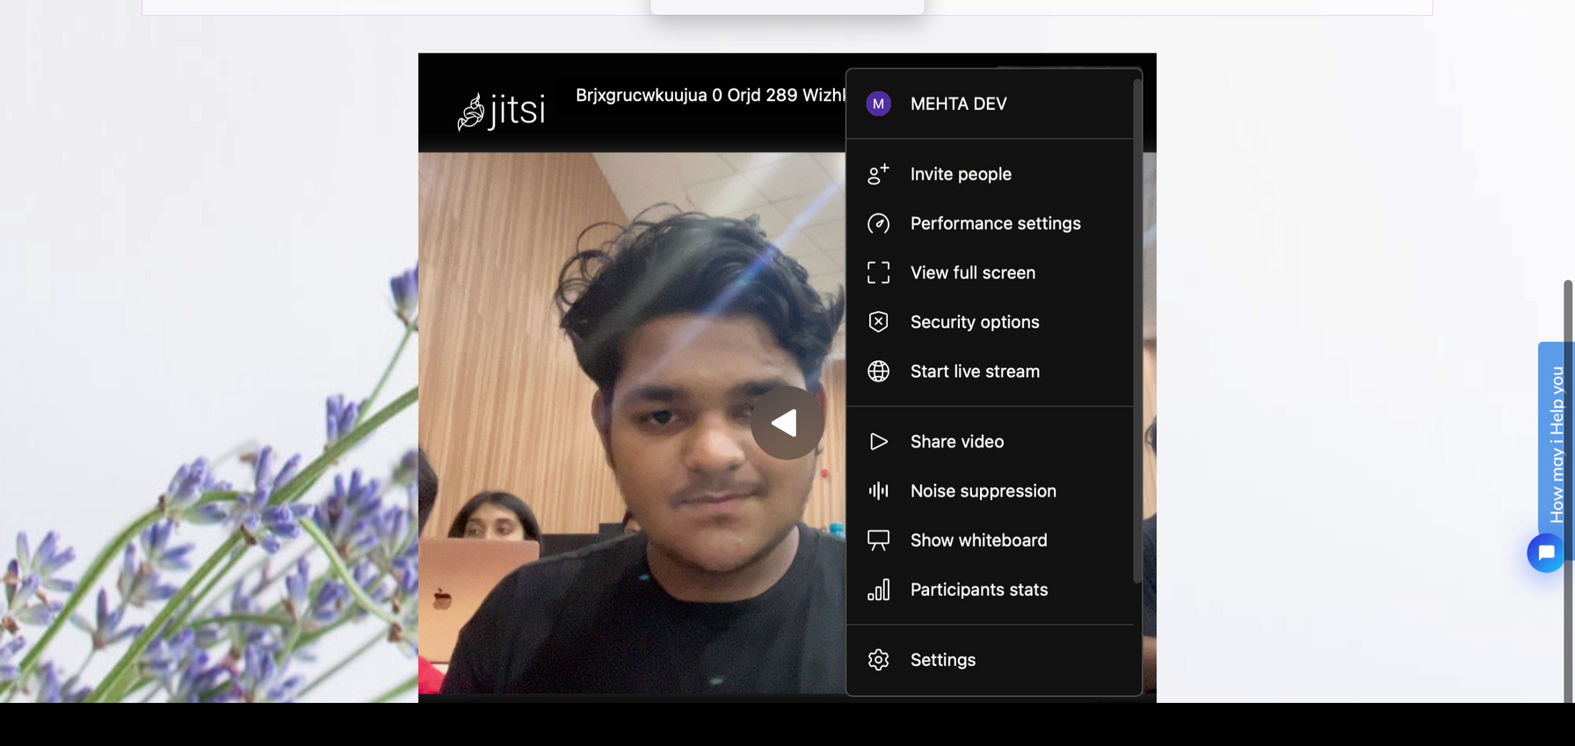

Webinar Software
Live Video Chat Interface
click here to see video
Invite people
Performance setting
View full screen
Security Options
Start Live stream
Share Whiteboard
Noise Suppression
Participants Status
Share Video

Slide 5
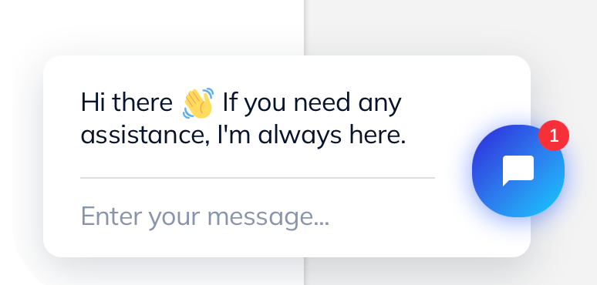
AI ASSISTANT
demo video here
(1) Multi-lingual
(2) User-Friendly
(3)Assists with any difficulty

Slide 6


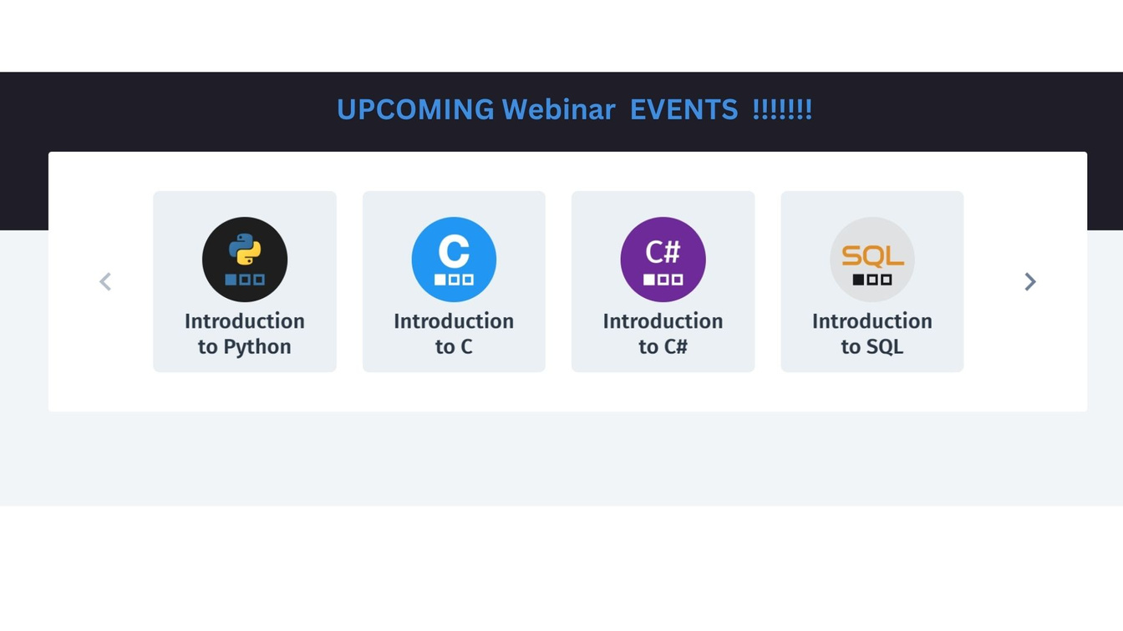

Final Website

Slide 7
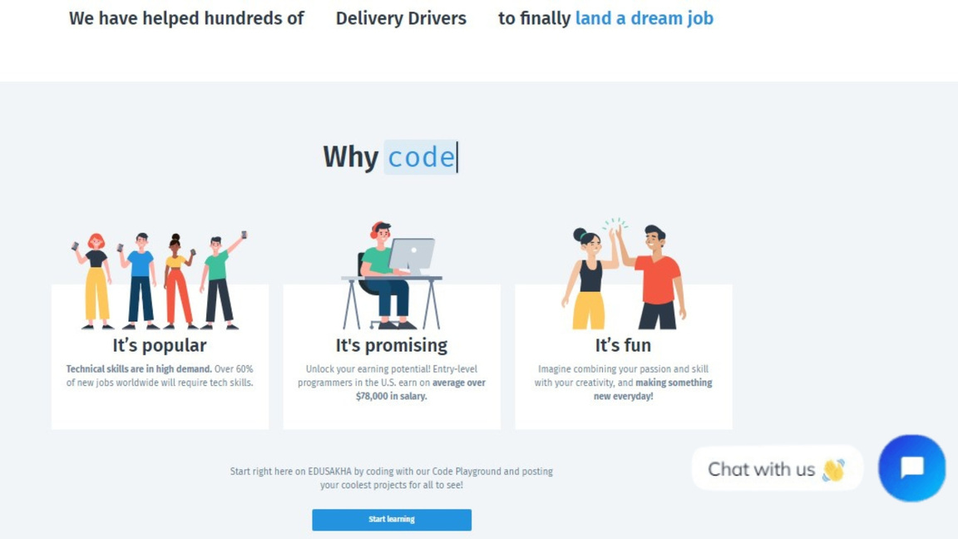
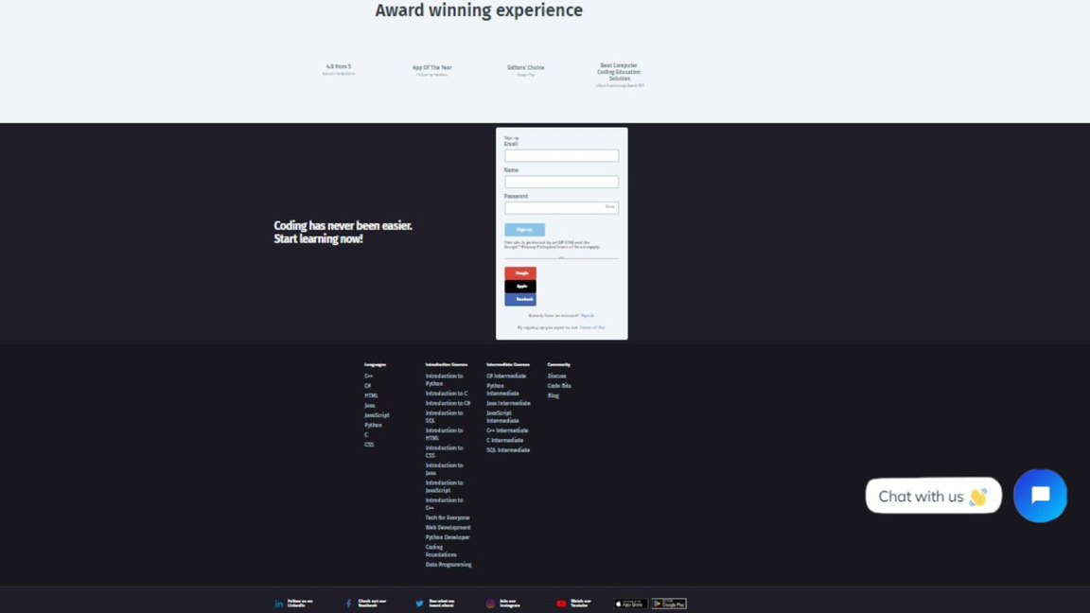
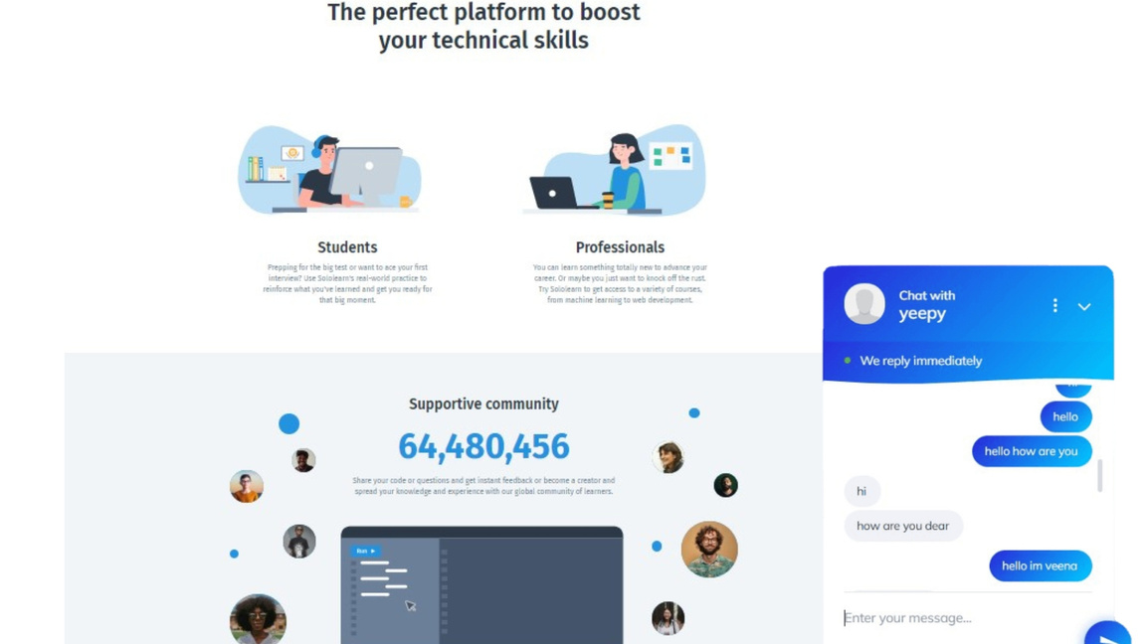
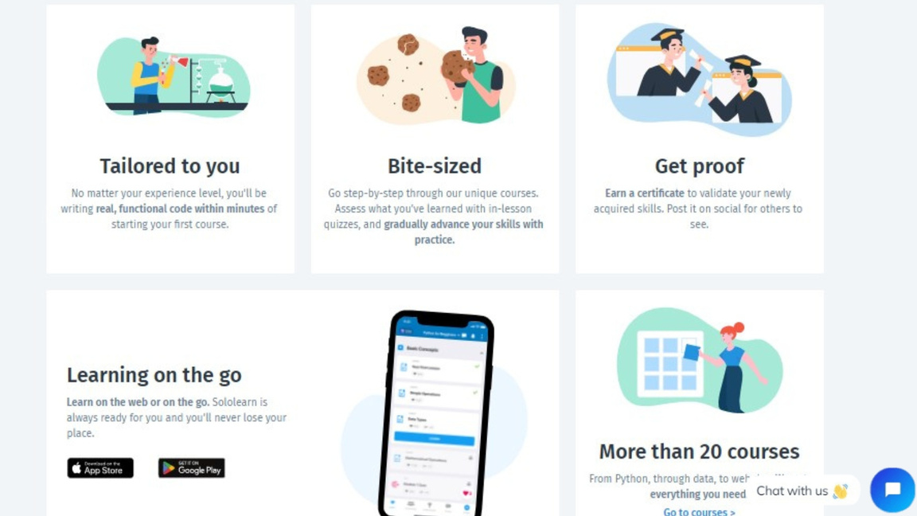

Slide 8
Main Key Feature
Integrated live video streaming for webinars and real-time campus tours.
Text-based Q&A for interactive engagement.
Youtube Live Stream
Recorded video on youtube
Universities can access event participation metrics
Event Schedule
E-mail notification on confirmation

Slide 9
RETURN OF INVESTMENT
A STUDENT OF 3-TIER COLLEGE/RURAL WILL BE ABLE TO ATTEND WEBINARS OF 2 & 1 TIER COLLEGES
This system is widely demanded as the similar versions are very costly so this might be accepted more by the education system
The formula for ROI is (Net gain from investment)/(cost of investment)*100
The strategies for revenue generation might be through ticket sales, sponsorships & partnerships while managing the cost for the technology& marketing.

Slide 10
Thank You
Team InnoTech Titans

